Slide 1
Intro to Android

Slide 2
The Smartphone Platform
With the iPhone being the first to the marketplace it sets the configuration of the Smartphone Platform
  3G/4G connectivity
  WiFi connectivity
  Bluetooth connectivity
  accelerometer w/compass
  ambient light sensor
  proximity sensor
  GPS
  gyroscope

Slide 3
What is Android
Android is an open source operating system, created by Google specifically for use on mobile devices (cell phones and tablets)
Linux based (2.6 kernel)
Can be programmed in C/C++ but most app development is done in Java (Java access to C Libraries via JNI (Java Native Interface))
Supports Bluetooth, Wi-Fi, and 3G and 4G networking

Slide 4
Commonly Used Packages
User interface controls and widgets
User interface layout
Secure networking and web browsing
Structured storage and relational databases (SQLite RDBMS)
2D and 3D Graphics SGL and OpenGL
Audio and visual media support
Access to optional hardware (GPS)

Slide 5
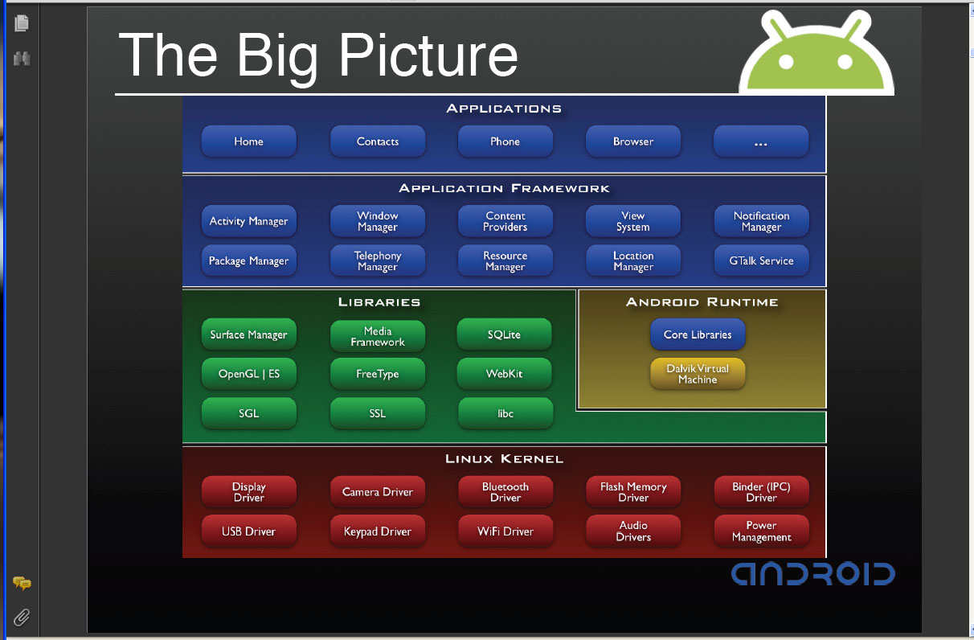
The Android Software Stack

Slide 6
Android Application Development
Android
SDK
Eclipse IDE
Android
Mobile
Device
Android
Emulator

Slide 7
Android development
Java Source
Android Manifest
Generated Class
Java Compiler
.dex
File
Dalvik
VM
Resource XML
Android Libraries

